Slide 1
Data related jobs
A project by : Rawad Okla

Slide 2
Introduction
This data shows the compares various aspects of data related jobs (Data science, Data analysis , ML Ops and Big data ) such as job type and title , experience level , salaries and cities which each opportunity is available.
In this presentation we will ask a couple of questions that can help us detect the problem and aim towards the goal

Slide 3
Problem : Detect which one of the data related jobs is suitable for the reader according to multiple factors .
Goal : compare the four job titles using four questions
what is the salary average for each job depending on the city and level of expertise ?
What is the salary development for each job ?
What are the cities with most internship opportunities ?
What are the cities with most entry-level opportunities ?

Slide 4
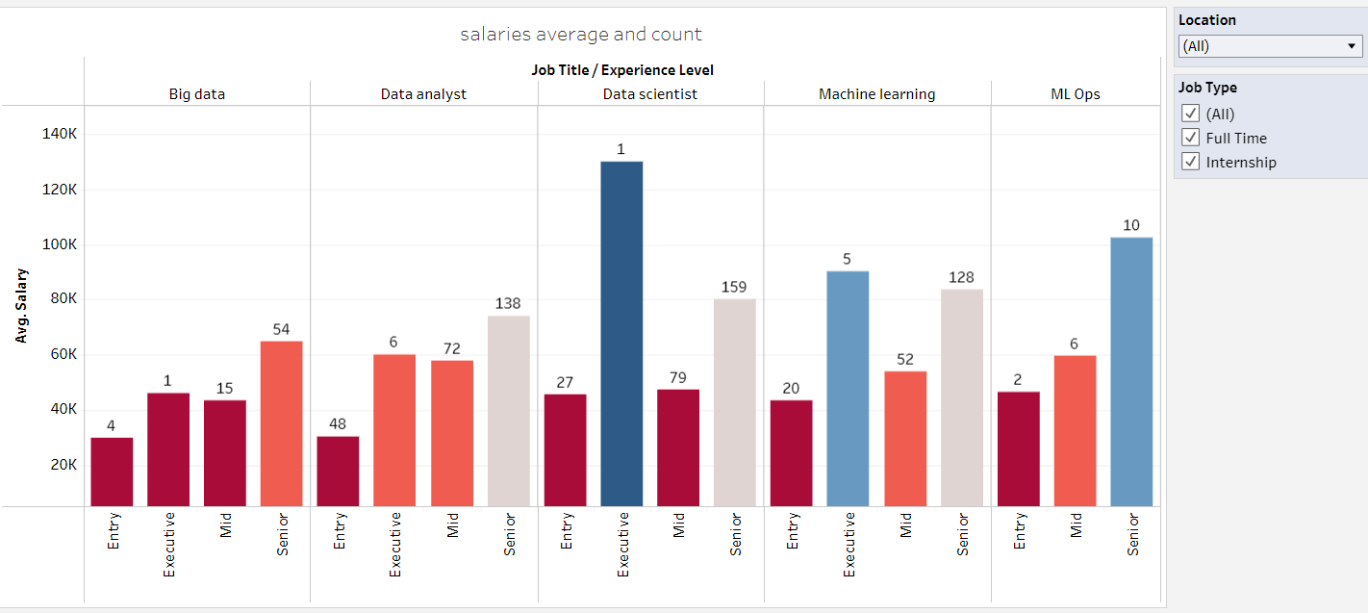
what is the salary average for each job depending on the city and level of expertise

Slide 5
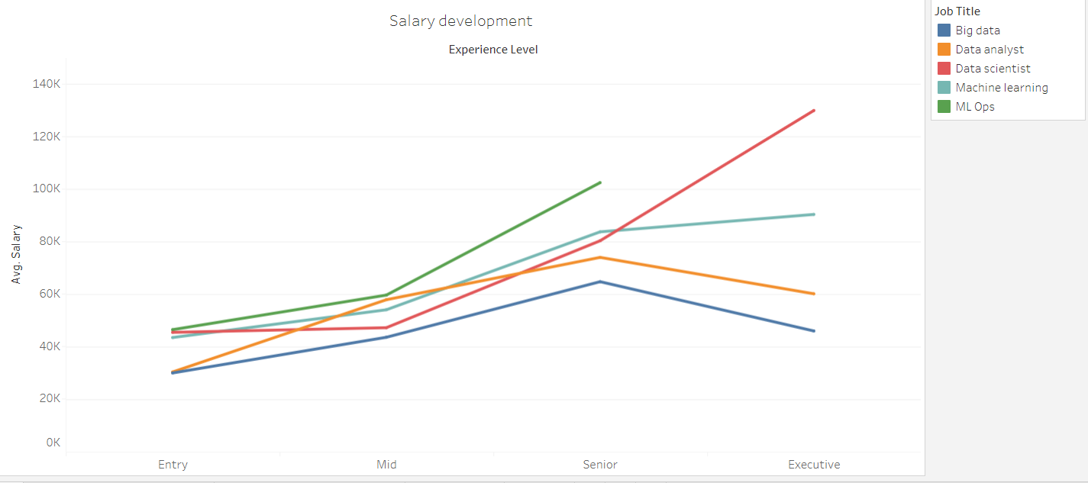
What is the salary development for each job ?

Slide 6
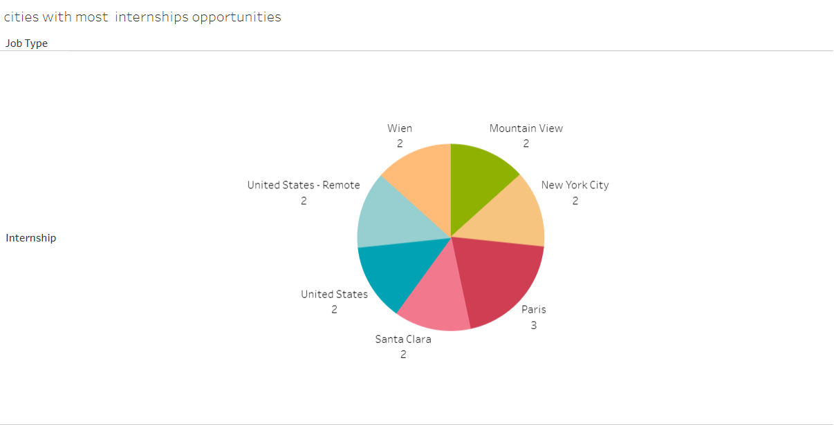
What are the cities with most internship opportunities?

Slide 7
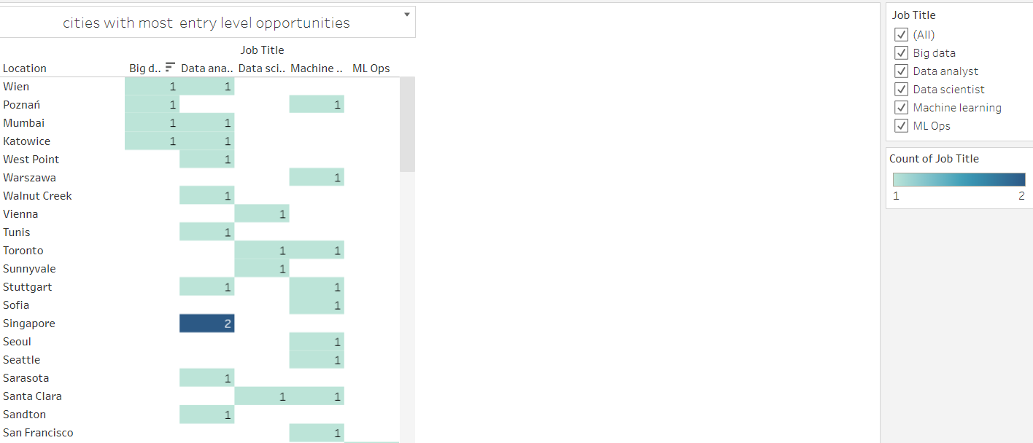
What are the cities with most entry-level opportunities

Slide 8
For in depth review of the above mentioned charts you can see the dashboard :
https://public.tableau.com/app/profile/rawad.okla/viz/Datarelateedjobs/Dashboard1

Slide 9
Conclusion
There is no clear way to decide definitely which Job title or City is the best. It all depends on the viewer’s conditions and preferences .

